Slide 1
Verification - Diagnosis - Repair: Toward Automatic Network Configuration Management via Formal Methods
Qiao Xiang,
joint work with
Jiwu Shu, Lizhao You, Xing Fang, Ziyi Wang, Rulan Yang,
Chenyang Huang, Yuxin Wang, Ridi Wen,
Xiwen Fan, Qiuyue Qin, Hanyang Shao, Huisan Xu,
Gao Han, Bang Huang, Kexin Yu
08/13/2023

Slide 2
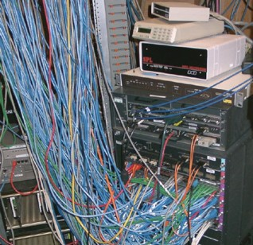
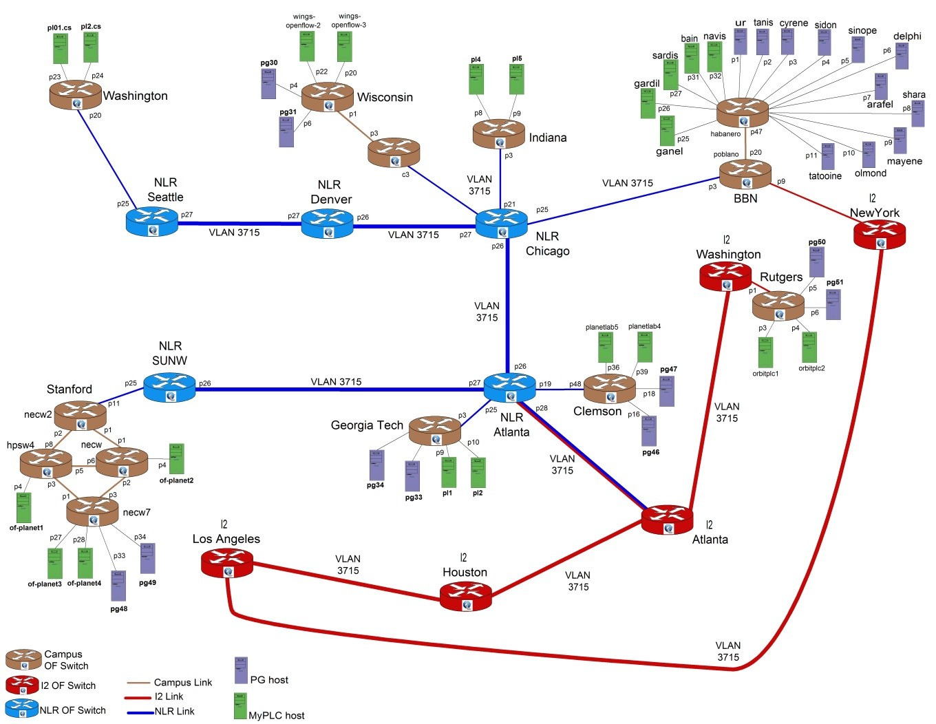

Background
Modern networks are
increasingly more complex
outages increasingly more costly
Source: http://groups.geni.net/geni/chrome/site/thumbnails/wiki/TangoGENI/OF-VLAN3715_1000.jpg

Slide 3
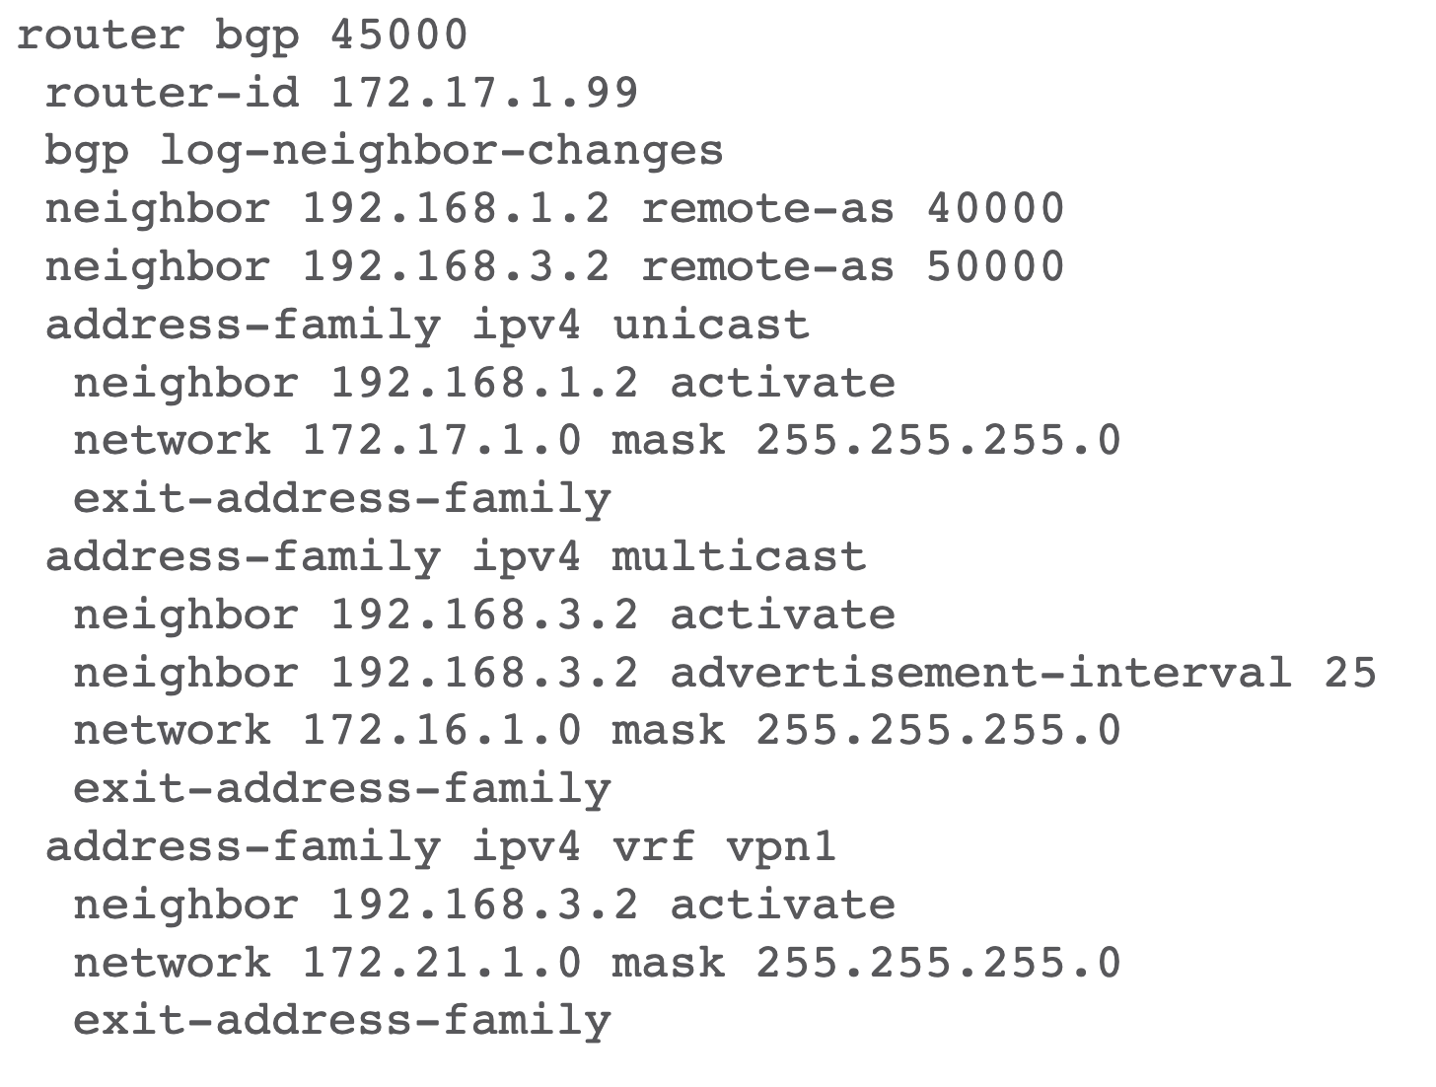
Network Verification: Powerful Tool to Check Network Forwarding Behavior
Control plane verification: examine the configurations of routers before they are deployed

Slide 4
Control Plane Verification
Simulation based tools: Batfish [NSDI'15], Hoyan [SIGCOMM'21]
Fast, generic, but cannot deal with multiple converged states
Graph based tools: ARC [SIGCOMM'16], Tiramisu [NSDI'22]
Fast in certain settings, but not generic, nor can deal with multiple converged states
SMT based tools: Bagpipe [OOPSLA'16], Minesweeper [SIGCOMM'17]
Generic, can verify all converged states, but unscalable

Slide 5
Data Plane Verification:
Control Plane
Data Plane
config
FIB
execute
config
FIB
FIB
config
Control plane verification
Batfish [NSDI'15]
Bagpipe [OOPSLA'16]
Minesweeper [SIGCOMM'17]
Bonsai [SIGCOMM'18]
Hoyan [SIGCOMM'21]
…
Data plane verification
HSA [NSDI'12]
Veriflow [NSDI'13]
Atomic Predicates [ICNP'13]
APKeep [NSDI'20]
Flash [SIGCOMM'22]
…
Notes:
Traditional operators don’t use verification
That may be changing with new tools like HSA, Veriflow
Still, there is simulation in the mix, because the control plane will be simulated

Slide 6
Why Study Data Plane Verification?
Data plane is the ground truth of actual forwarding behavior
Q: Why CP verification fails to catch this?
A: ACL/routing configurations pass control plane verification, but with a different input from the actual network

Slide 7
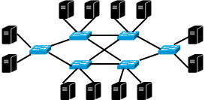
How Does DPV Usually Work?
A (cluster of) server(s) as a centralized verifier
Collect the data plane (e.g., FIB/ACL) from routers/switches through management network
Run computation-intensive, memory-intensive computation to verify the network data plane
Verifier
Management
Network
FIB/ACL
FIB/ACL
FIB/ACL
FIB/ACL

Slide 8
Issues of Centralized DPV
Need a highly-available management network
Incomplete DP, inconclusive result
Verifier becomes performance bottleneck
Larger network, more computation power
Verifier becomes single PoF
Verifier fails, no result
Out-of-band verification
Slow reaction to errors
Verifier
Management
Network
FIB/ACL
FIB/ACL
FIB/ACL
FIB/ACL

Slide 9
Our Proposal: Distributed, On-Device Verification
Basic idea: offload verification to distributed computations on network devices
Benefits:
Minimize the requirement of management network
Once configured, run automatically
No performance bottleneck
More network devices, more verifiers
No single PoF
Device malfunction equals a network error
Verification-as-a-service for vendors
Support flexible in-situ fast reroute
Verifier
On-device tasks
On-device tasks
On-device tasks
On-device tasks
Management
Network
FIB/ACL
FIB/ACL
FIB/ACL
FIB/ACL

Slide 10
Tulkun: A Generic, Distributed, On-Device DPV Framework
Invariant specification
Declarative Invariant Specification Language
Verification
Invariant
Network
Topology
+
DVNet
lightweight tasks decomposition
Verification Planner
On-Device Tasks
collaborative verification
On-Device Verifiers
/ DV Protocol
Verification Messages

Slide 11
A Running Example
Invariant: all packets entering the network from S with a destination IP in 10.0.0.0/23 must be delivered to D in a simple path waypointing W.
Topology:
B
C
S
A
D
W
10.0.0.0/23

Slide 12
Step 1: Invariant Specification
Invariant: all packets entering the network from S with a destination IP in 10.0.0.0/23 must be delivered to D in a simple path waypointing W.
Tulkun program:
(dstIP = 10.0.0.0/23, [S], S .* W .* D and loop_free, "exist >=1")
packet space
set of
valid paths
number of
valid paths
ingress

Slide 13
Step 2: From Invariant and Topology to DVNet
Invariant:
DVNet: a DAG representing all valid paths in the network
(dstIP = 10.0.0.0/23, [S],
S .* W .* D and loop_free, "exist >=1")
B1
C2
X (DFA multiplication)
S1
A1
W1
W2
Topology:
B
C
W3
C1
S
A
D
W
10.0.0.0/23
B2
D1
DP Verification: count how many valid paths exist in the data plane.
DP Verification on DVNet: count valid paths via reverse topological traversal

Slide 14
Step 3: From Verification in Network to Counting in DVNet
B
C
S
A
D
W
10.0.0.0/23
Each node counts # of downstream paths provided by data plane in reverse topological order
[(P₁, 0)]
[(P₁, 0)]
[(P₂, [0, 1]),
B1
C2
(P₃, 1)]
S1
A1
[(P₁, 1)]
W1
W2
[(P₂, [0, 1]),
[(P₁, 0)]
[(P₁, 1)]
(P₃, 1)]
[(P₁, 1)]
W3
C1
Error found!
P₁: dstIP=10.0.0.0/23
P₂: dstIP=10.0.0.0/24
P₃: dstIP=10.0.1.0/24
[(P₁, 1)]
[(P₁, 1)]
B2
D1

Slide 15
Step 4: Distributed, Event-Driven, On-Device Counting
B
C
S
A
D
W
10.0.0.0/23
Counting in DVNet can be naturally decomposed and executed at corresponding devices
[(P₁, 0)]
[(P₁, 0)]
[(P₂, [0, 1]),
B1
C2
[(P₁, 1)]
(P₃, 1)]
[(P₁, 1)]
S1
A1
[(P₁, 1)]
[(P₁, 1)]
W1
W2
[(P₂, [0, 1]),
[(P₁, 0)]
[(P₁, 1)]
(P₃, 1)]
fwd(ALL, {W})
[(P₁, 1)]
W3
C1
P₁: dstIP=10.0.0.0/23
P₂: dstIP=10.0.0.0/24
P₃: dstIP=10.0.1.0/24
[(P₁, 1)]
[(P₁, 1)]
B2
[(P₁, 0)]
D1

Slide 16
Tulkun: Extensions
Data plane with packet transformation
Sub-pub mechanism added to on-device tasks
Message-free local verification
All-path-availability: any task finding error equals network error (Microsoft RCDC [SIGCOMM'19] becomes a special case)
Fault-tolerant invariant (e.g., shortest path under k-link-failure)
Precomputing fault-tolerant DVNet
Incremental deployment
device/vm interconnect + partition

Slide 17
Implementation
A total ~8K lines of Java code
On-device verifier runs on SONiC and ONL
Requirement: JRE
SONiC HLD proposal
https://github.com/sonic-net/SONiC/pull/948
To be open-sourced upon publication

Slide 18
Experiment 1: Functionality Demonstration
6-switch testbed: 4 Mellanox, 1 UfiSpace, 1 Edgecore
Demo scenarios:
Waypoint reachability (running example)
Multicast
Anycast
Different-ingress consistent reachability
All-shortest-path availability
Demo videos: http://distributeddpvdemo.tech/
Interactive demos: https://distributeddpchecking.com:8443
B
C
S
A
D
W

Slide 19
Experiment 1: Verifying Internet2
9-switch testbed with Internet2 topology: 4 Mellanox, 4 P4, 1 Edgecore whitebox
Inject propagation latency among switches based on device location in topology
Public Internet2 data plane dataset
Snapshot, all-rule verification: finish verifying all-pair loop-free, blackhole-free, <=x+2-hop reachability in 0.99 second
10,000 incremental, per-rule-update verification: 80% finish in <=5.42ms

Slide 20
Experiment: Large-Scale Simulations
13 datasets spanning campus networks, WAN and DCN
Compare with 5 centralized DPV tools: Veriflow [NSDI'13], Deltanet [NSDI'17], AP [ICNP'13], APKeep [NSDI'20], Flash [SIGCOMM'22]

Slide 21
Simulation: Snapshot Verification
Tulkun accelerates snapshot verification by up to 1250x

Slide 22
Simulation: 10,000 Incremental Per-Rule-Update Verification
Tulkun verifies at least 73% of rule updates in less than 10 ms and up to 2355x faster than SOTA in 80% quantile

Slide 23
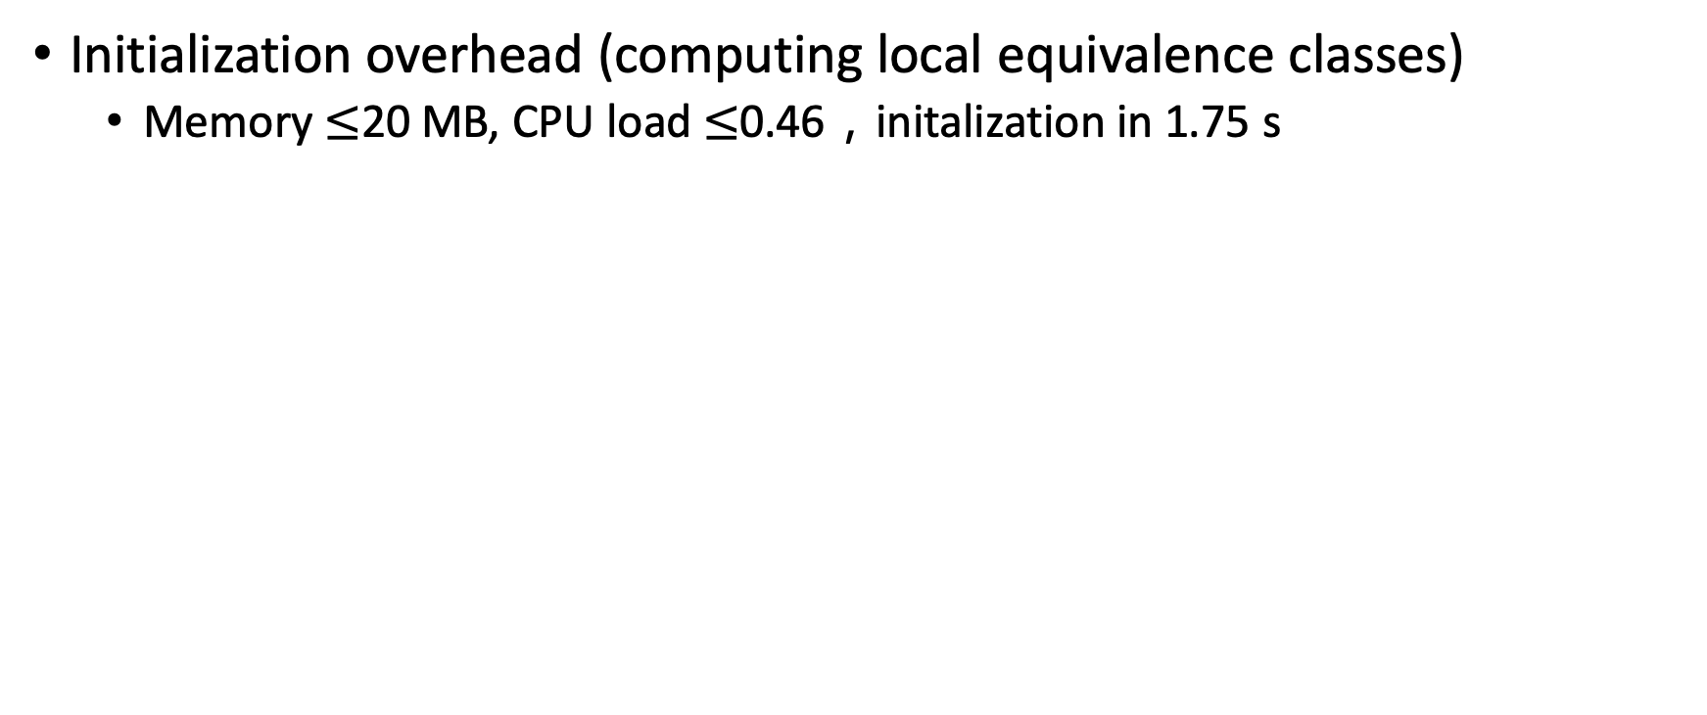
Experiment: Microbenchmark on Commodity Switches
Initialization overhead (computing local equivalence classes)
Memory $≤$20 MB, CPU load $≤$0.46，initalization in 1.75 s

Slide 24
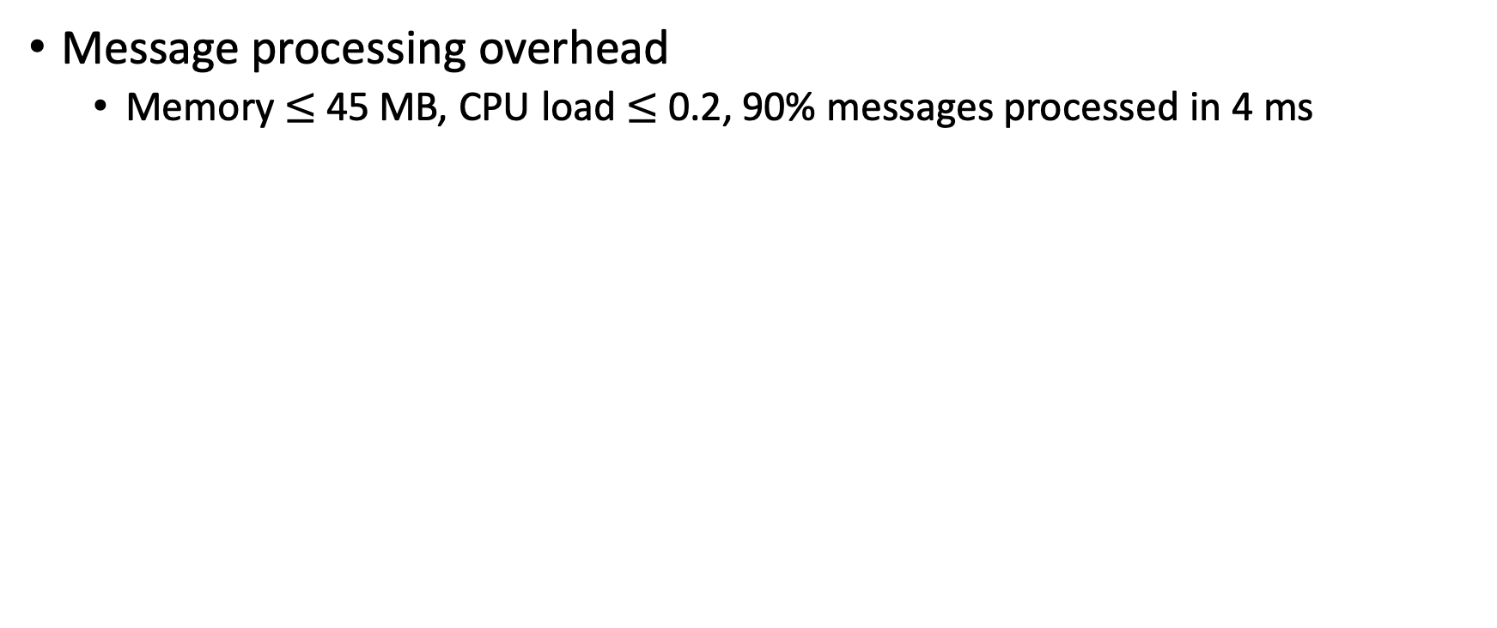
Experiment: Microbenchmark on Commodity Switches
Message processing overhead
Memory $≤$45 MB, CPU load $≤$ 0.2, 90% messages processed in 4 ms

Slide 25

Summary
For more information about Tulkun，reach out by email (qiaoxiang@xmu.edu.cn) or WeChat
Advantages of distributed DPV over centralized DPV:
better scalability, no single PoF, verification-as-a-service for vendors
Tulkun design elements:
declarative invariant specification language; planner via DVNet; on-device verifier and messaging protocol
Extensive evaluation using demo/testbed/simulation/microbenchmark: real-time, scalable in-network verification
Publications: ACM HotNets'22, ACM SIGCOMM'23
Open-source/demos：https://github.com/sonic-net/SONiC/pull/948
https://distributeddpchecking.com:8443/
http://distributeddpvdemo.tech/

Slide 26
What Happens After Verification?
CPV
A-Graph [INFOCOM'21]
NetSMT [WIP]
Verification
DPV
Flash [SIGCOMM'22]
Coral [HotNets'22]
[SIGCOMM'23]
Repair
Diagnosis
Diagnosis / Repair
Scalpel [APNet'23]

Slide 27


Why Is Verification Not Enough?
Verification: answer a YES/NO question
reachability √
waypoint ×
...
Configurations
Network model
Results
translate the configuration to another representation
check if properties hold for the model
Verification tools | Network model they generate | The way they verify properties
Simulation-based tools (e.g., Batfish) | RIB/FIBs (i.e., The data plane) | Data plane verification → Compute and verify the data plane
Graph-based tools (e.g., ARC) | Abstraction graph | Compute graph invariants
SMT-based tools (e.g., Minesweeper) | Logic formula | Check the satisfiability of the formula
Notes:
Such as simulation based-tools, they compute and verify the data plane
SMT-based tools, they model the network and properties as a logic formula and check the satisfiability of the formula.
It is still up to operators to diagnosis and repair

Slide 28

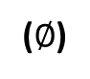
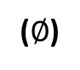
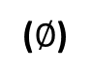
Why Is Diagnosis Hard?
Network is a (complex) distributed system: configuration errors on one router will lead to the property violation of other routers
Unobservable errors
Latent errors
Property: S-*-D
Reality: There is no path ($∅$) from S to D
A
S
($∅$)
D
S drops routes from A and B
($∅$)
([D])
B
D doesn’t redistribute the route to BGP process
($∅$)

Slide 29
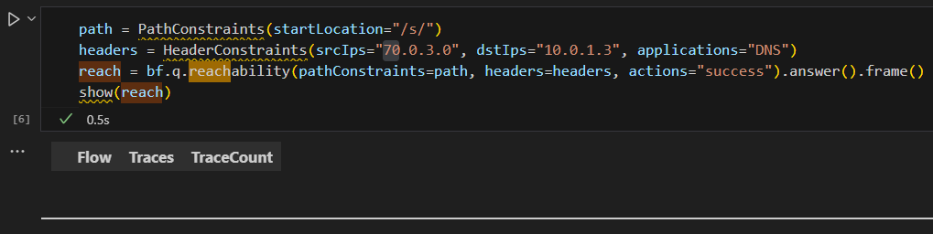
What Batfish Tells Us:
Batfish (simulation-based tool)
The simulation result: no flow
Notes:
If we use verification tools to verify this network,
let’s see, the left one is the result return from Batfish, a state-of-the-art simulation-based tool, we can know that the flow will go through S-A-D,
and the right one is minesweeper’s output, we only know the true/false result, furthermore, MS doesn’t support AS-path regular expression.
but we still don’t know How do the configuration errors contribute to the results, it needs manual efforts.

Slide 30
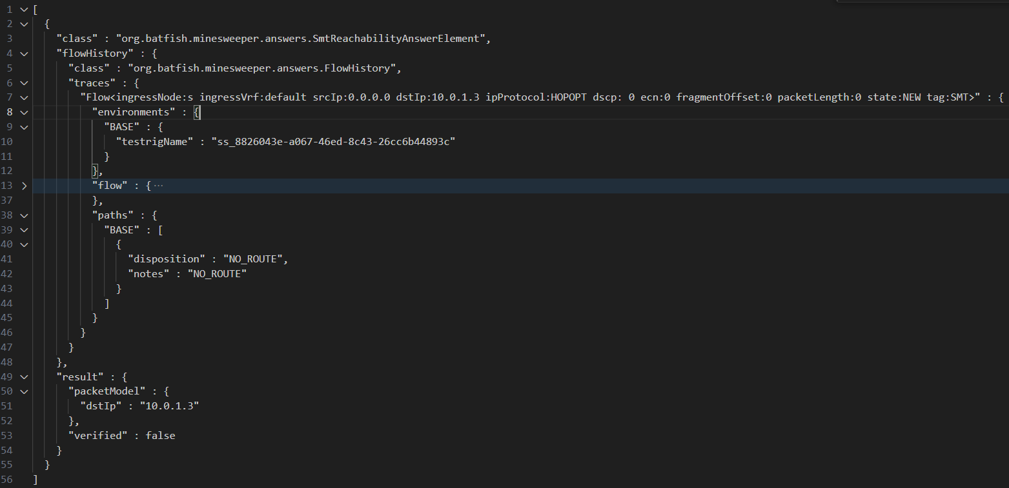
What Minesweeper Tells Us:
Minesweeper (SMT-based tool)
The counter-example: no flow, no route
Notes:
If we use verification tools to verify this network,
let’s see, the left one is the result return from Batfish, a state-of-the-art simulation-based tool, we can know that the flow will go through S-A-D,
and the right one is minesweeper’s output, we only know the true/false result, furthermore, MS doesn’t support AS-path regular expression.
but we still don’t know How do the configuration errors contribute to the results, it needs manual efforts.

Slide 31
Key Insight: Analyze the Control Flow of Distributed Routing (Program)
A
Receive
routes
r := queue.pop()
S
D
N
…
B
if (import(r) == true)?
Y
Route
selection
RIB-in.add(r)
Each routing process is a program consisting of the three parts
N
if (r > locRIB)
Y
Send routes
locRIB := r
N
if (export(locRIB)==true)?
Y
31
Notes:
We consider the execution trace is deterministic for the same network configuration.

Slide 32
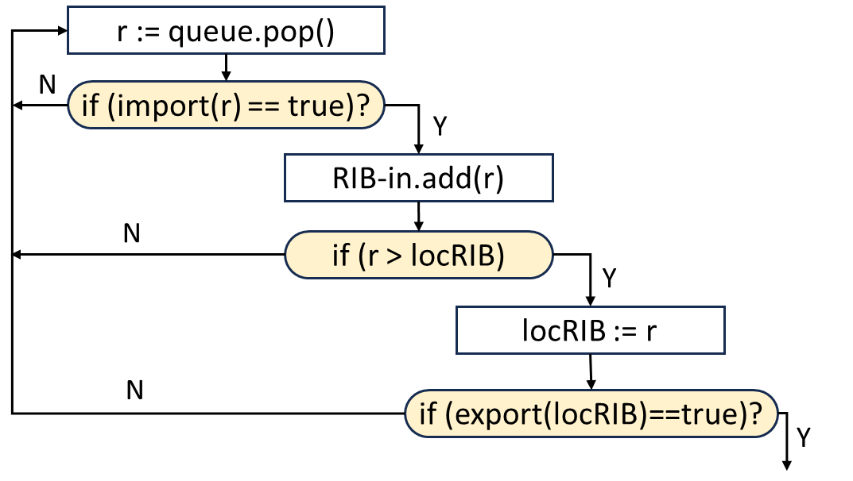
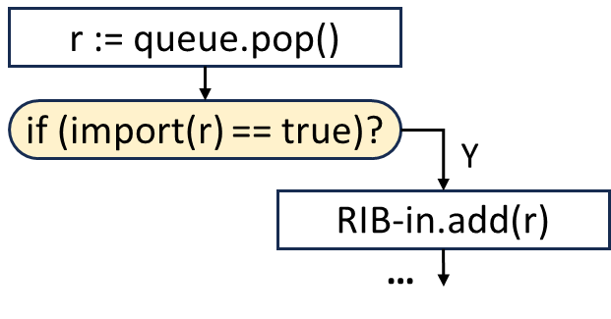
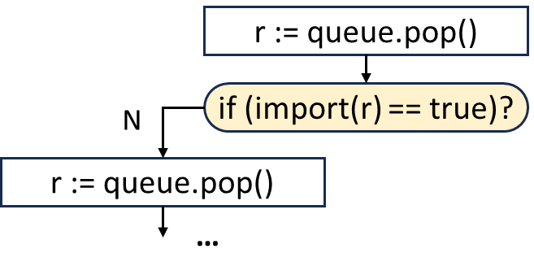
Control-Flow Analysis Using Symbolic Execution
Collect many execution traces with their path conditions at once
A path condition is a predicate that a symbolic execution trace needs to hold
How to diagnose? → Differentiate these traces
Program
Correct execution trace
Incorrect execution trace
Error: import(r) is false
Notes:
so we turn to CFA to get the control dependency of the program
Using symbolic execution we can explore other execution paths of the program.
after that we get the correct execution path, also the incorrect path, then we differentiate them to localize the different path conditions as errors.

Slide 33
Control-Flow Analysis Using Symbolic Execution
Collect many execution traces with their path conditions at once
Program
Data plane simulation
…
Conditions are attached as symbols with routes during the data plane simulation
A
S
D
B
Notes:
when D executes to the export branch, it supposes to go to the false branch, which means not to redistribute the static route to its BGP process, but the true branch is what we want to explore, so we make the export value as true and attach it as a symbol to the route
then keep executing using the symbolic route.
later we executes to the Import branch at S and we find that it will go to the false branch too, so we

Slide 34
Control-Flow Analysis Using Symbolic Execution
Collect many execution traces with their path conditions at once
Program
Data plane simulation
…
Conditions are attached as symbols with routes during the data plane simulation
Cond1: Export(Static→BGP)?
N
A
S
D
B
Notes:
when D executes to the export branch, it supposes to go to the false branch, which means not to redistribute the static route to its BGP process, but the true branch is what we want to explore, so we make the export value as true and attach it as a symbol to the route
then keep executing using the symbolic route.
later we executes to the Import branch at S and we find that it will go to the false branch too, so we

Slide 35
Control-Flow Analysis Using Symbolic Execution
Collect many execution traces with their path conditions at once
Program
Data plane simulation
…
Conditions are attached as symbols with routes during the data plane simulation
Cond1: Export(Static→BGP)?
N
Y
D(Static)->D(BGP)
([A, D], Cond1)
D->A
A
D->B
S
D
([D], Cond1)
B
([B, D], Cond1)
Notes:
when D executes to the export branch, it supposes to go to the false branch, which means not to redistribute the static route to its BGP process, but the true branch is what we want to explore, so we make the export value as true and attach it as a symbol to the route
then keep executing using the symbolic route.
later we executes to the Import branch at S and we find that it will go to the false branch too, so we

Slide 36
Control-Flow Analysis Using Symbolic Execution
Collect many execution traces with their path conditions at once
Program
Data plane simulation
…
Conditions are attached as symbols with routes during the data plane simulation
Cond1: Export(Static→BGP)?
N
Y
D(Static)->D(BGP)
([A, D], Cond1)
D->A
A
D->B
S
D
([D], Cond1)
Cond2:
Import (S←A, ([A, D]))?
B
N
([B, D], Cond1)
Notes:
when D executes to the export branch, it supposes to go to the false branch, which means not to redistribute the static route to its BGP process, but the true branch is what we want to explore, so we make the export value as true and attach it as a symbol to the route
then keep executing using the symbolic route.
later we executes to the Import branch at S and we find that it will go to the false branch too, so we

Slide 37
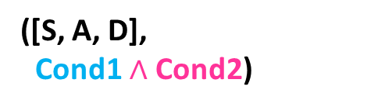
Control-Flow Analysis Using Symbolic Execution
Collect many execution traces with their path conditions at once
Program
Data plane simulation
…
Conditions are attached as symbols with routes during the data plane simulation
Cond1: Export(Static→BGP)?
N
Y
D(Static)->D(BGP)
([A, D], Cond1)
D->A
A
D->B
S
D
([D], Cond1)
Cond2:
Import (S←A, ([A, D]))?
([S, A, D],
Cond1 $∧$ Cond2)
B
Y
N
A->S
([B, D], Cond1)
…
Notes:
when D executes to the export branch, it supposes to go to the false branch, which means not to redistribute the static route to its BGP process, but the true branch is what we want to explore, so we make the export value as true and attach it as a symbol to the route
then keep executing using the symbolic route.
later we executes to the Import branch at S and we find that it will go to the false branch too, so we

Slide 38
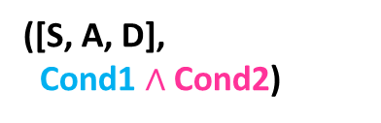
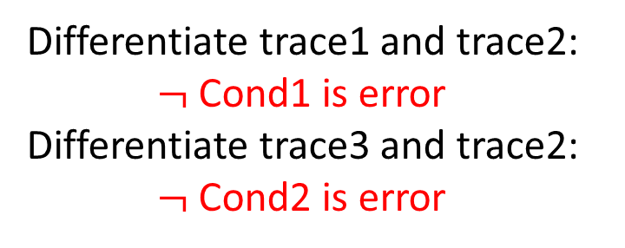



Control-Flow Analysis Using Symbolic Execution
Collect many execution traces with their path conditions at once
Cond1: Export(Static→BGP)?
Differentiate trace1 and trace2:
$¬$Cond1 is error
Differentiate trace3 and trace2:
$¬$Cond2 is error
N
Y
Cond2: Import (S←A, ([A, D]))?
Trace 1
Y
N
Trace 2
Trace 3
Trace 1: $¬$Cond1
Trace 2: Cond1 $∧$ Cond2
Trace 3: Cond1 $∧$ $¬$Cond2
([A, D], Cond1)
([A, D], Cond1)
A
A
A
S
D
S
D
S
D
B
([S, A, D],
Cond1 $∧$ Cond2)
B
B
([D], Cond1)
([D], Cond1)
([B, D], Cond1)
([B, D], Cond1)
Notes:
when D executes to the export branch, it supposes to go to the false branch, which means not to redistribute the static route to its BGP process, but the true branch is what we want to explore, so we make the export value as true and attach it as a symbol to the route
then keep executing using the symbolic route.
later we executes to the Import branch at S and we find that it will go to the false branch too, so we

Slide 39
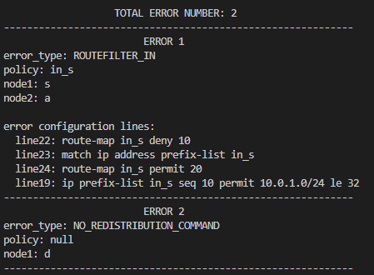
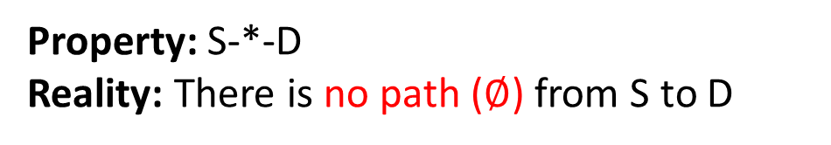
Diagnosis Results
Property: S-*-D
Reality: There is no path ($∅$) from S to D
A
S
Error1: The route-map in S (line 19, 22-24) filtered routes from A
D
Error path conditions :
Cond1: Export(Static→BGP) is false
Cond2: Import (S←A, ([A, D])) is false
Error2: There was no redistribution command in node D
Notes:
we report all errors and related configuration lines of them, which is helpful for operators to fix the error.

Slide 40
Evaluation
Evaluate Scalpel on synthetic configurations
Routing protocols: BGP, static route
Protocol features: redistribution, route filters
Networks size: O(10)~O(100) routers
O(100) lines of configuration per router
Errors injection: propagation-deny error, origin-deny error

Slide 41
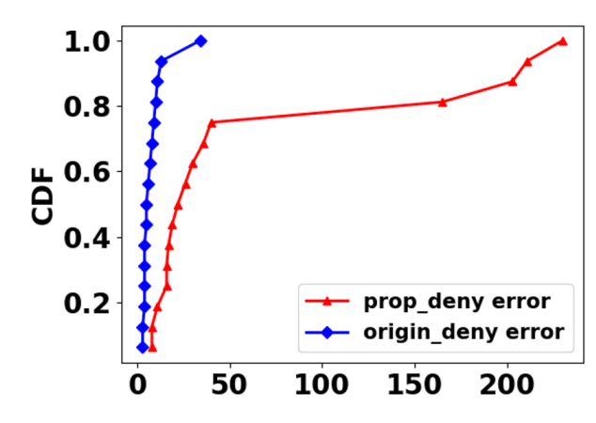
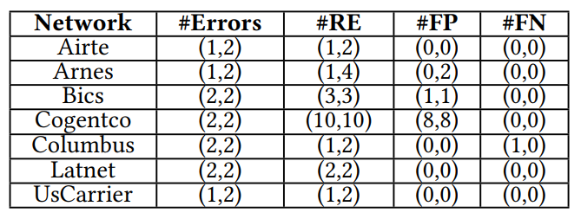
Evaluation
We diagnose 74% of errors within 50ms
Diagnosis time on unobservable errors (ms)
Table: Diagnosis results on unobservable errors

Slide 42
Summary
We take the first step to apply program analysis to distributed router configuration diagnosis.
We design Scalpel, an automated router configuration diagnosis tool.
We implement Scalpel and demonstrate the capability of Scalpel.
Notes:
questions 可以直接列

Slide 43
Open Research Questions
Non-deterministic execution (e.g., leveraging Hoyan’s design)
Supporting more protocols (e.g., link state protocols)
Scaling control-flow analysis for large networks (e.g., slicing)
Automatic repair based on diagnosis (e.g., constraint-based repair)
Notes:
questions 可以直接列

Slide 44
Verification - Diagnosis - Repair: From One to Many Networks
CPV
A-Graph [INFOCOM'21]
NetSMT [WIP]
Verification
Interdomain
Configuration
Interdomain Synthesis
SDI [INFOCOM'20]
DPV
Flash [SIGCOMM'22]
Coral [HotNets'22]
[SIGCOMM'23]
Interdomain
Verification
IVeri [arXiv'21]
ICoral [WIP]
InCV [APNet'23]
Repair
Diagnosis
Interdomain
Repair
IRepair [WIP]
Diagnosis / Repair
Scalpel [APNet'23]

Slide 45

A Case for Interdomain Configuration Verification
In real-world operations, AS S can only find that it cannot reach P after all ASes deploy their configurations.
AS C
prefer E as next hop
AS S
AS A
AS B
AS E
AS D
AS F
IP prefix P
drop all paths containing E
Fundamental challenge: each AS treats its configuration as private information.

Slide 46
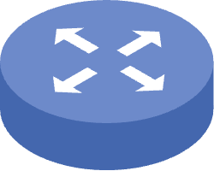
Proposal: Privacy-Preserving Interdomain Verification
Leverage secure multi-party computation to allow participating ASes to collaboratively verify their BGP configurations while keeping them private.
Secure multi-party computation
private configurations

Slide 47

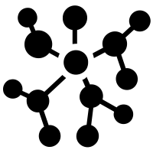


lnCV: Architecture and Workflow
√
AS’s agent A
B
D
E
(2) DO-Simulation
Topology information (public)
Secret data-plane (private)
C
(3) DO-DPV
Result (public)
Intermidiate
representation
(private)
User requirement (public)
AS A
B
D
E
(1) Configuration transformation
C

Slide 48
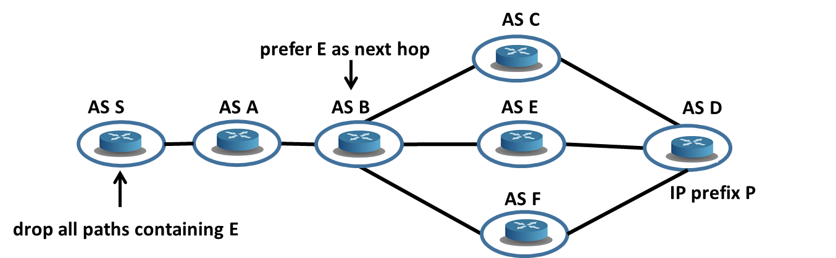

DO-Simulation: BGP Simulation
Global update status
0 | 0 | 1 | 0 | 1 | 1 | 0
Import filter
Export filter
0 | 0 | 0 | 1 | 0 | 0 | 0
Route selection
Global update status
RIB
Import filter
Export filter
Route selection
……
RIB
Select an AS to process its advertisement message.
Simulate route advertisement considering export and import filters.
Simulate route selection & update RIBs.
Import filter
Export filter
Route selection
RIB
Notes:
In each iteration, the AS whose advertisement list is not empty will be chosen.
Then, the node will send the route advertisements in the list to its neighbors. The export and import functions filter will be considered.
The compare function compares the import routes with the current best path. If the import route has higher priority according to the route attributes, the best path and advertisement list will update. There are two types of route advertisements

Slide 49
DO-Simulation:
From BGP Simulation to Data-Oblivious Simulation
SMPC-primitives: 𝑛-party SMPC primitives based on Shamir’s secret sharing.
(e.g. addition,multiplication,comparison)
Data-obliviousness:
encode key input as data-oblivious data structures (e.g., vectors and matrices).
execute both branches of conditional statements (i.e., if) to hide actual execution sequence.
SMPC
primitives
SMPC
Data-obliviousness
A data-oblivious algorithm built on SMPC
primitives makes an SMPC [1]
[1] S. Dov Gordon, Jonathan Katz. et al. 2012. Secure Two-Party Computation in Sublinear (Amortized) Time. In CCS ’12. ACM, 513–524.

Slide 50
Accelerating DO-simulation with
Global Optimal Order of Announcements
AS C
Key idea: Let ASes with global optimal route announcements send their updates first.
To support the non-monotonic networks, we implement the route withdrawal operation on top of FASTPLANE [2].
prefer E as next hop
AS S
AS A
AS B
AS E
AS D
AS F
IP prefix P
drop all paths containing E
Withdrawal
happens
ASes’ order in desecending global priority:
D C E F B A S
[2] Nuno P. Lopes and Andrey Rybalchenko. 2019. Fast BGP Simulation of Large Datacenters. In VMCAI’19. Springer, 386–408

Slide 51
DO-DPV: Data-Oblivious Property Checking
AS C
prefer E as next hop
AS S
AS A
AS B
AS E
AS D
DFS-based traversal algorithm on the simulated data-plane [3]
For some properties (e.g. blacklisting), a linear scan on the source’s RIB would suffice.
AS F
IP prefix P
drop all paths containing E
Secret data-plane
IP prefix | AS path
… | …
Encoded by Shamir’s secret sharing.
no agent can independently know the network data plane
[3] Marina Blanton. et al. 2013. Data-Oblivious Graph Algorithms for Secure Computation and Outsourcing. In ASIA CCS’13. ACM, 207-218.

Slide 52

Evaluation: Settings
Environment:
We implement our system on MP-SPDZ [4].
Topology & configurations:
27 synthesized networks ranging from 6 to 32 ASes as datasets.
~100 lines of configuration for each AS
Correctness of InCV.
Overhead of InCV.
Efficacy of simulation acceleration.
Correct in all experiments.
[4] Marcel Keller. 2020. MP-SPDZ: A Versatile Framework for Multi-Party Computation. In CCS’20. ACM, 1575–1590.

Slide 53
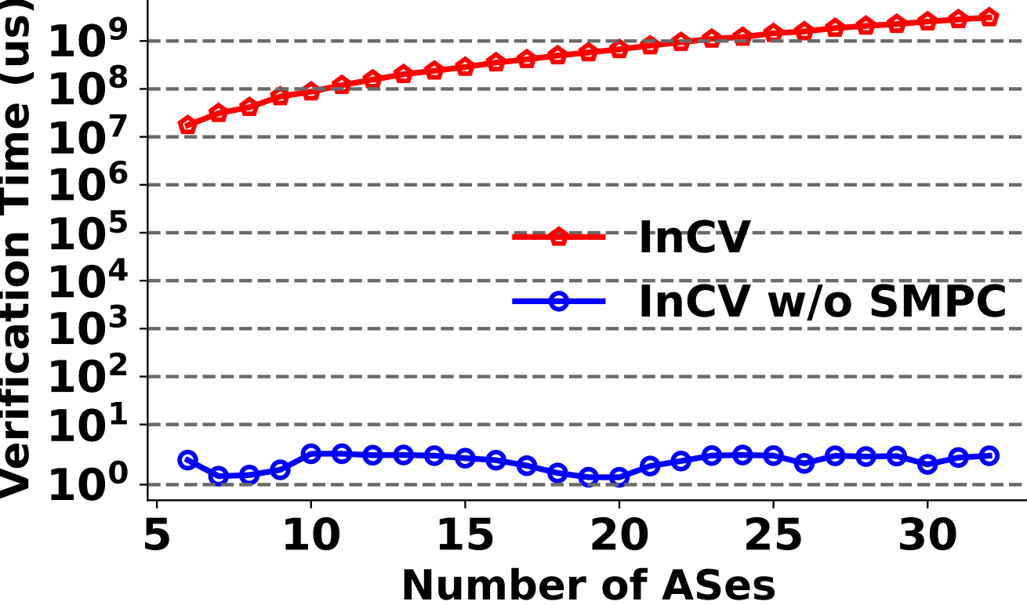
Overhead of InCV
Verification time of InCV
InCV can verify a network of 32 ASes at ∼52 minutes.

Slide 54
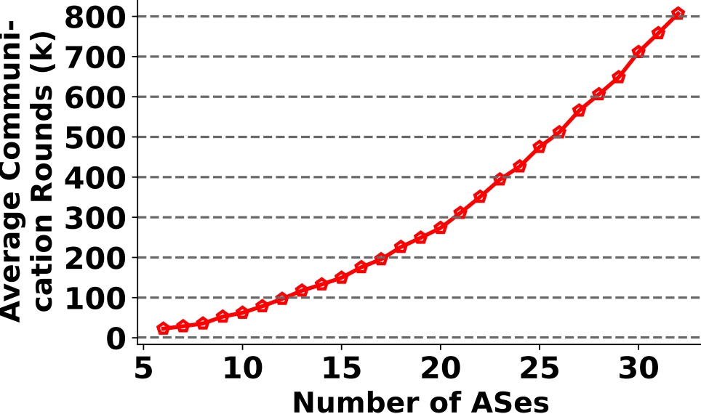
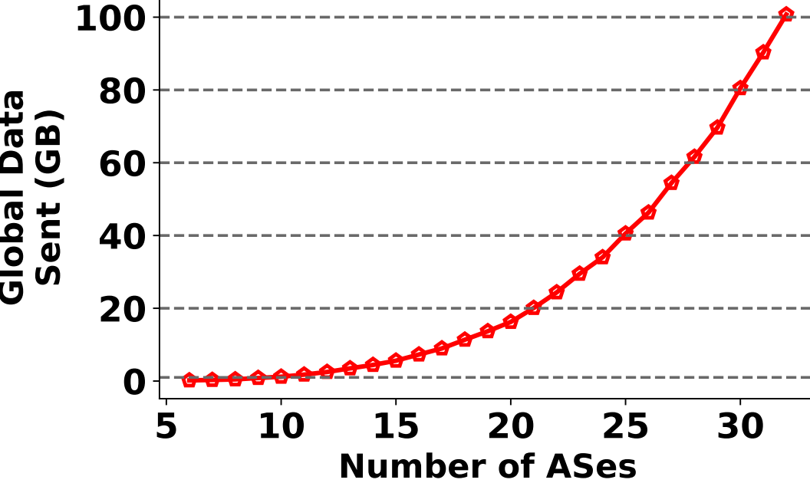
Overhead of InCV
Preliminary results show interdomain verification is feasible.
The communication overhead of agents is acceptable at ∼ 30 ASes.

Slide 55
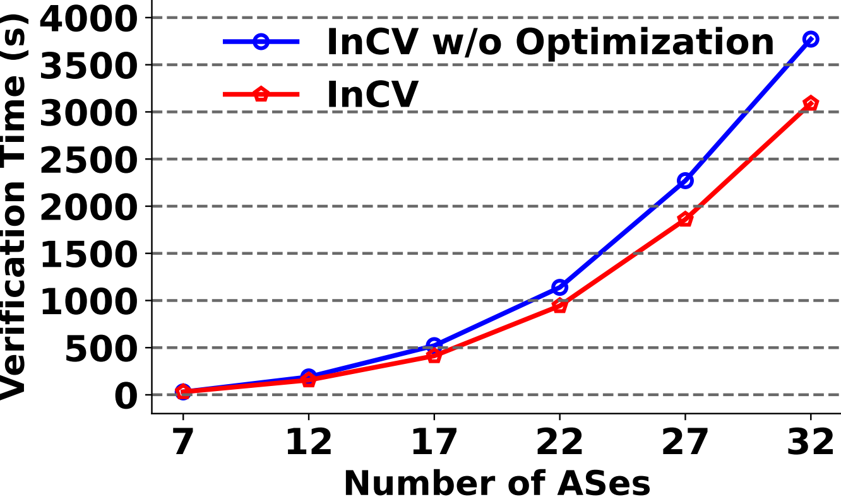
Efficacy of Simulation Acceleration
Preliminary results show interdomain verification is feasible.
The performance of simulation optimization
About 19% acceleration has been achieved for the network with 32 ASes.

Slide 56
Summary
We take a first step to study interdomain network configuration verification.
We design InCV, a first privacy-preserving interdomain network configuration verification system.
We implement InCV and demonstrate the capability of InCV.

Slide 57
Open Research Questions
Optimizations to scale interdomain verification for larger networks
More complex BGP route attributes and interdomain network properties
Incremental interdomain configuration verification
Incremental deployment
Stronger security model

Slide 58
Next Steps: From Reliability to Performance
CPV
A-Graph [INFOCOM'21]
NetSMT [WIP]
Verification
Interdomain
Configuration
Interdomain Synthesis
SDI [INFOCOM'20]
DPV
Flash [SIGCOMM'22]
Coral [HotNets'22]
[SIGCOMM'23]
Many exciting research problems and collaboration opportunities await!
Interdomain
Verification
IVeri [arXiv'21]
ICoral [WIP]
InCV [APNet'23]
Repair
Diagnosis
Interdomain
Repair
IRepair [WIP]
Diagnosis / Repair
Scalpel [APNet'23]

Slide 59

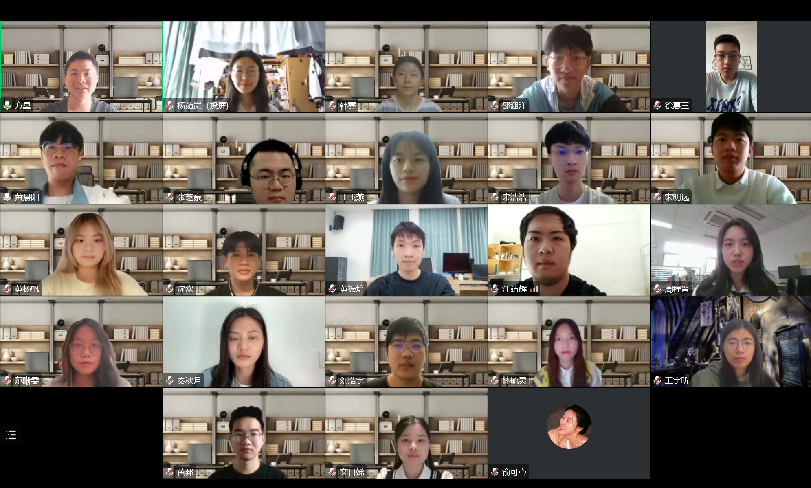




XMU SNGroup
SNGroup: sngroup.tech
Contact us: sngroup.xmu@outlook.com
Welcome to Visit Us!
Young team
6 PhD students
20 graduate students
4 undergraduates
Fun research
Network and formal methods
Programmable networks
High-performance networks
Interpretable intelligent networks

